Slide 1
Assignments
Class 2

Slide 2
Exercise 1
When the price of a Whopper falls from $4.00 to $2.00, the quantity of Whopper demanded increases from 10 to 30. Calculate the price elasticity of demand.
When the price of a Whopper falls from $4.00 to $2.00, the quantity of Big Macs drops from 40 to 25. Calculate the cross-price elasticity of demand.
An increase in the income by 5% results in an income elasticity of 0.5. Calculate the change (%) in the quantity demanded.

Slide 3
Exercise 2
Draw the budget line given the following information:
Income m = 20
Price of beer = 1
Price of pizza = 5
Note: use the Y-axis for the quantity of beer and the X-axis for the quantity of pizza
Calculate how much beer must be forgone for 1 pizza.
What is the MRT of this budget line?
Draw the new budget line if the price of beer changes to 2.
Calculate the MRT of the new budget line.
Draw the new budget line if the income decreases to 15.
Calculate the MRT of the new budget line.

Slide 4
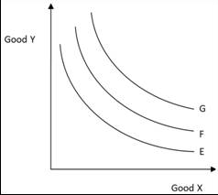
Exercise 3
Consider the indifference map below:
Which of the following statements it true?
The consumer will prefer indifference curve G to indifference curve E
The consumer will prefer indifference curve E to indifference curve F
Indifference curve G and indifference curve E yield the same level of utility
Indifference curve F yields a higher level of utility than indifference curve G

Slide 5
Exercise 4
Draw an indifference curve for:
Bread and peanut butter
They are complements (exercise 3 answer B)
Ice cream and milk shake
Substitute, (we aren’t looking at production, only consumer that’s why its not complements)
Samsung Galaxy S6 and Iphone 6
A
Left shoe and right shoe
B

Slide 6
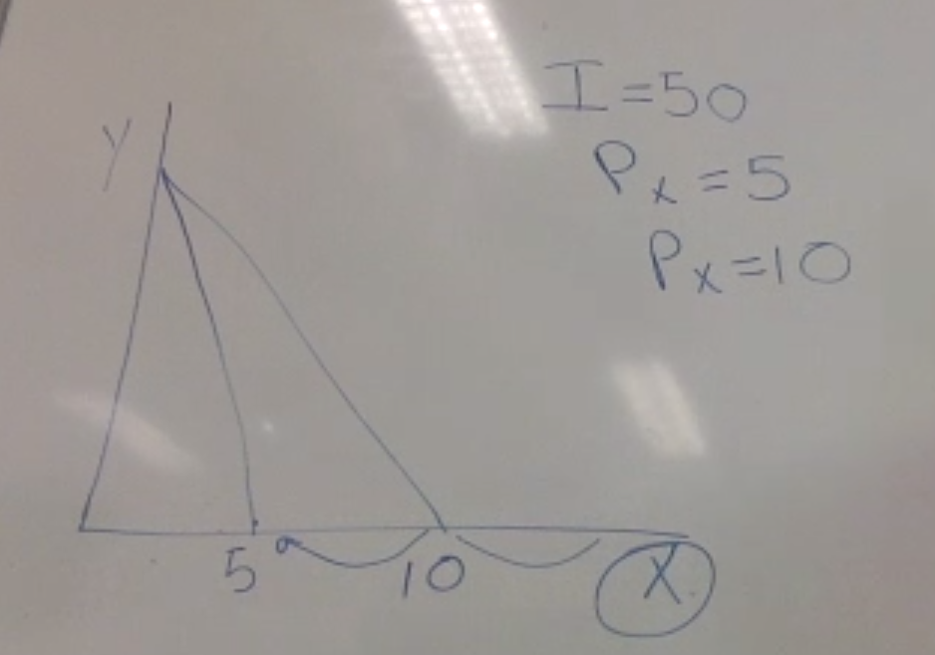
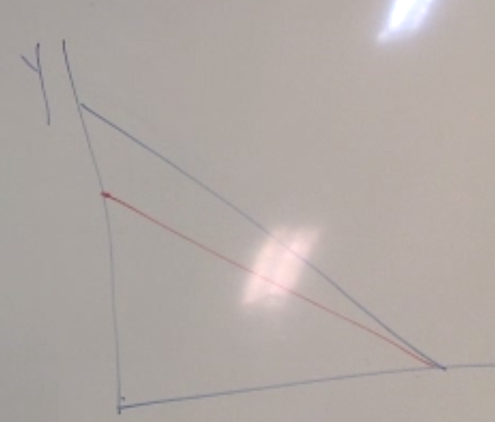
Exercise 5
Consider a consumer’s budget constraint line. If the price of one good increases while the price of the other good and the consumer's income remain unchanged, what will happen to the budget constraint line? (draw the diagram and show what will happen with the budget constraint line).

Slide 7
Exercise 6
If the price elasticity is -5, what happens with the quantity demanded if the price increases by 10%?
The government wants to reduce the consumption of electricity by 5%. The price elasticity of demand for electricity is -0.4. What should the government do with the price? (calculate the % change)

Slide 8
Exercise 7
The cross-price elasticity of demand between good A and good B is -0.5. Good A and good B are
Substitutes
Complements
Inferior goods
Luxury goods

Slide 9
Exercise 8
Lori consumes Frappuccino’s and muffins at the local coffee shop. Her monthly budget to spend on these two goods is NAf.50. The price of a large Frappuccino is NAf.12.50 while the price of a muffin is NAf.5.00
Draw Lori’s budget constraint line with the amount of Frappuccino’s on the Y axis and the amount of muffins on the X axis.
Suppose Lori’s tastes and preferences are such that with this budget constraint line, her optimal choice is when she consumes 2 Frappuccino’s.
Given this new information and the budget constraint line, how many muffins does Lori consume in the optimal choice?
5 muffins
What is the marginal rate of substitution (MRS) in this optimal choice?
-1 * (5/12.50) = -0.4 (-1*x/y) (price)

Slide 10
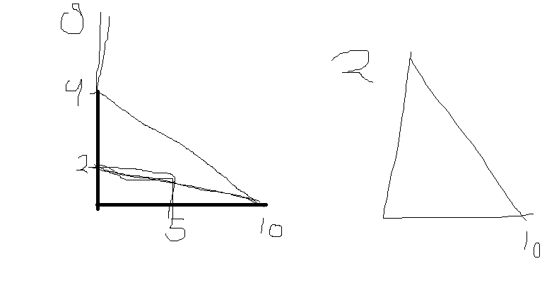

Slide 11
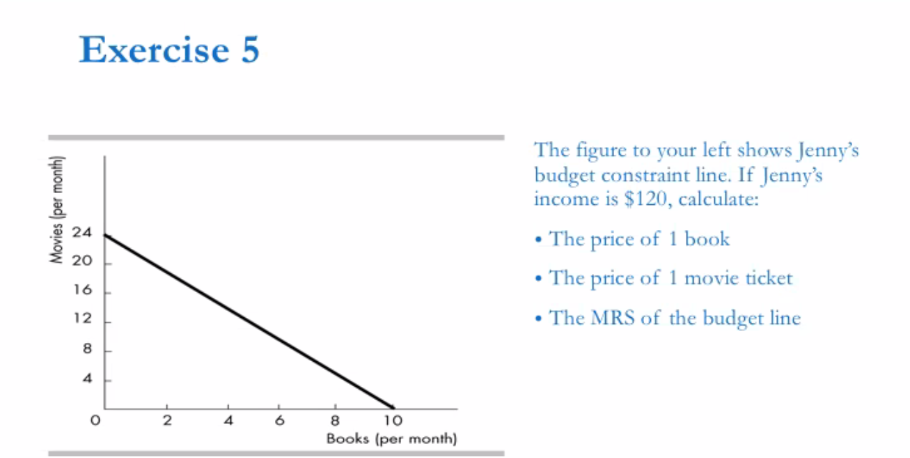
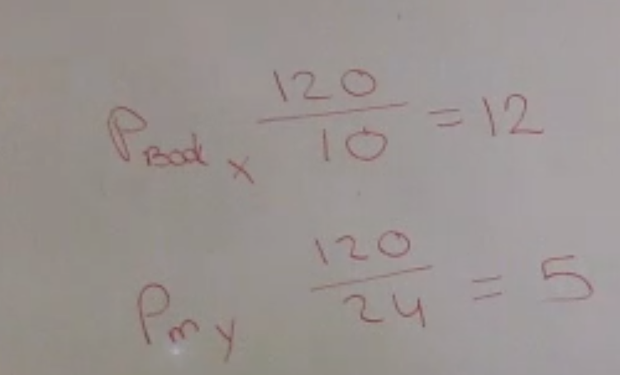
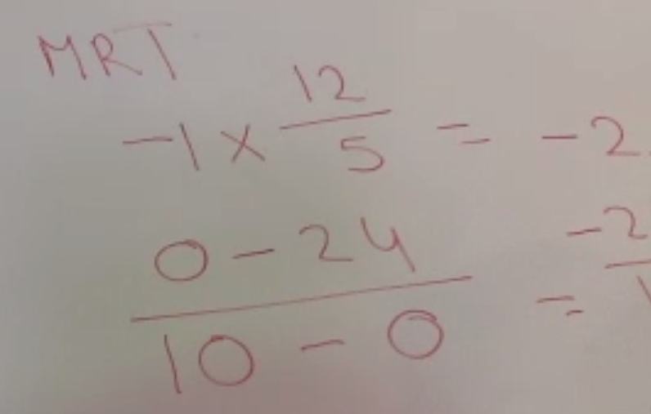

Slide 12
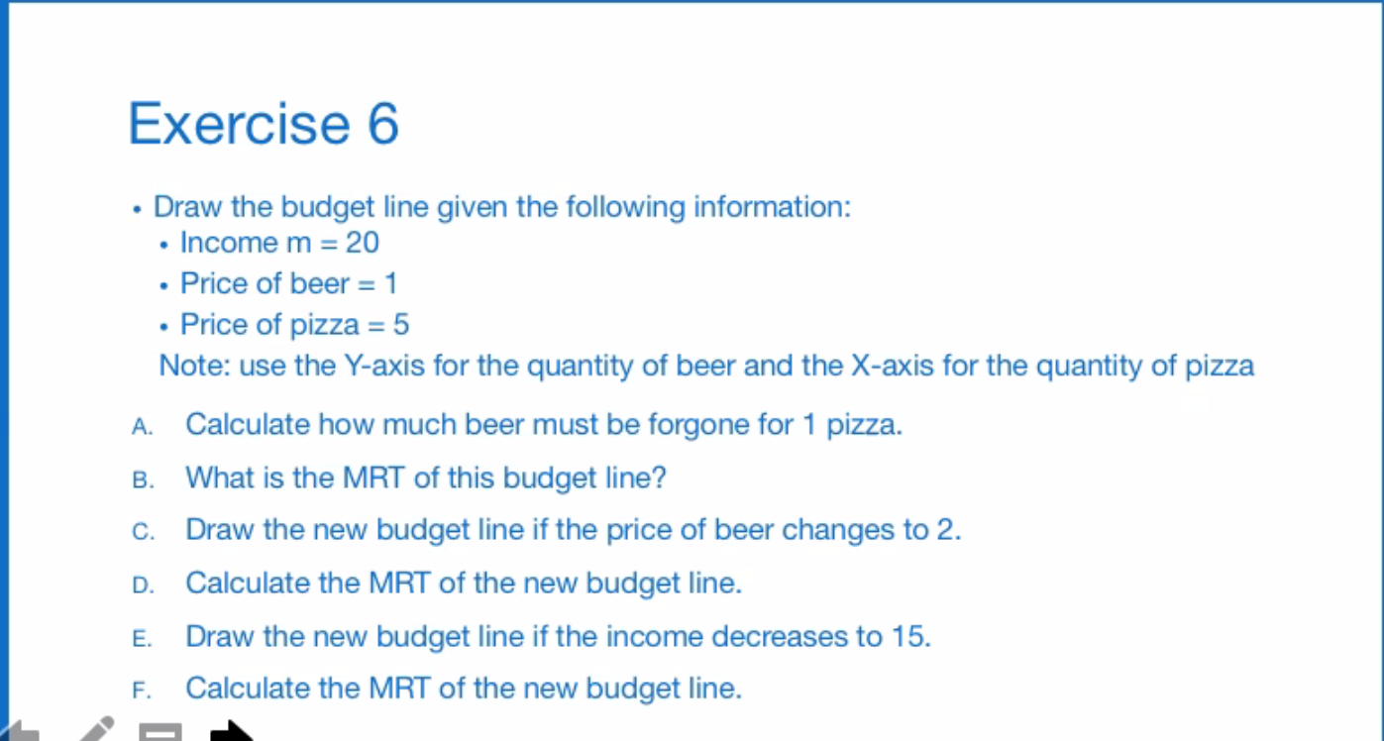
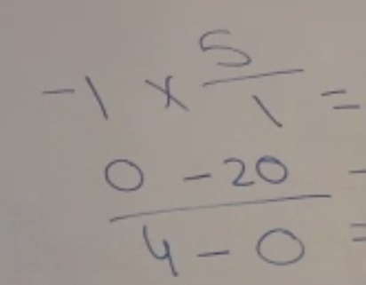
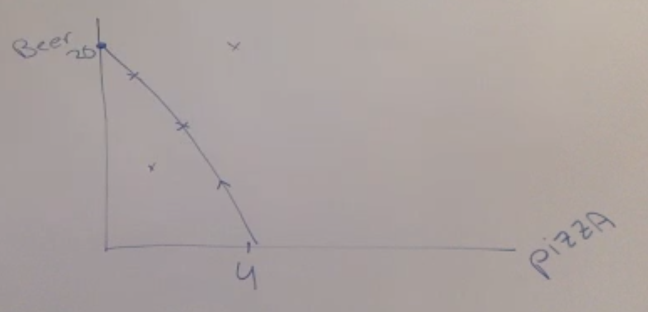

Slide 13

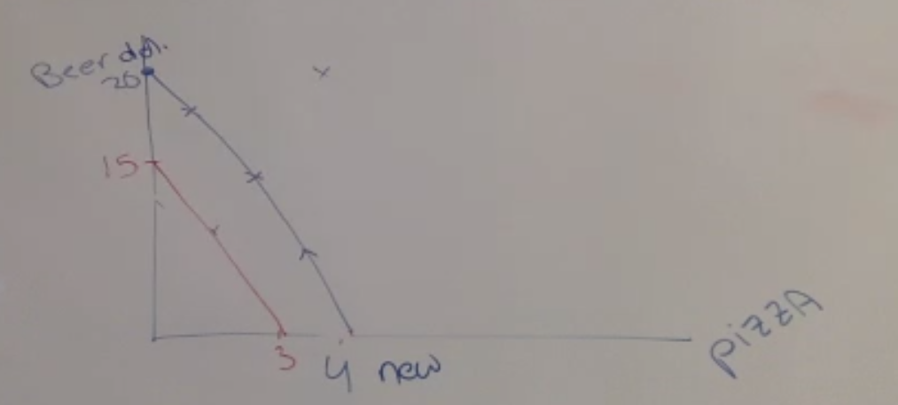

Slide 14


